Slide 1
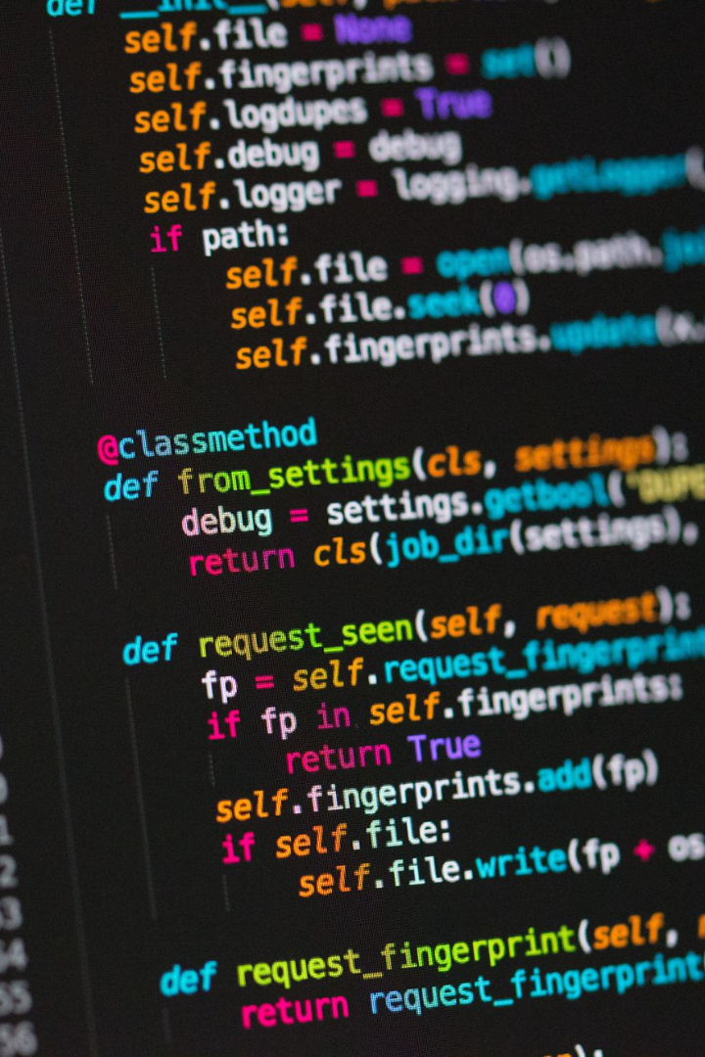

Python - Control Structures
Conditionals are a fundamental part of programming. In this presentation, we will explore the basics of Python conditionals with plenty of examples to help you understand how they work.
by Anik Acharjee

Slide 2
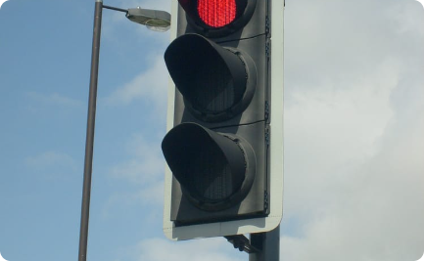
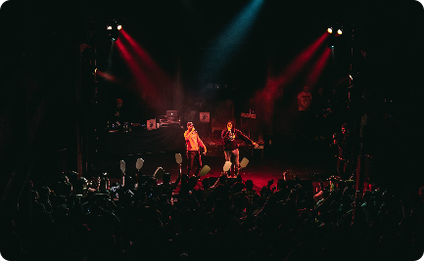
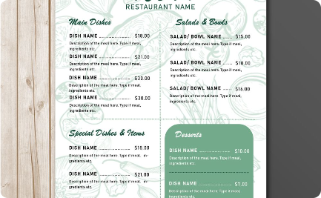
Simple if statement
Example 1
Example 2
Example 3
Using the simple if statement to control traffic light.
Checking if you have the necessary tickets to attend a music concert.
Determining if you have enough money to eat at your favorite restaurant.

Slide 3
If-else statement
Example 1
Example 2
Example 3
Use the if-else statement to check if you have enough money to buy a new gadget.
Checking if a movie is worthy of your time based on its ratings and genre.
Checking for duplicates in a data set using if-else conditionals.

Slide 4
Elif statement
Example 2
Determining the grade of a student depending on their scores - A, B, C, D, or F.
1
2
3
Example 1
Example 3
Determining what you can do for fun depending on the weather - sunny, cloudy, rainy.
Deciding which mode of transport is most economical for a long-distance trip - train, plane or bus.

Slide 5
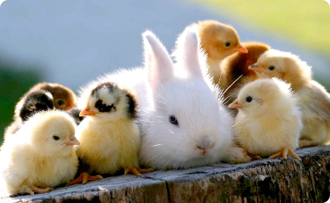

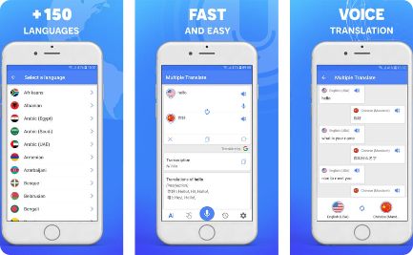
Nested if statement
Example 1
Example 2
Example 3
Determining the name of a baby animal depending on its type.
Checking if a soldier is a veteran or a rookie based on the number of wars they have participated in.
Checking if an input word is available in the language translation app's database.

Slide 6
Iteration Control (Looping)
Example 1
Example 2
Example 3
Printing the prime numbers from a given list, using a for loop.
Printing the Fibonacci series up to a certain number, using a while loop.
Checking the length of a string, using a for loop.

Slide 7
Break statement
Example 2
Checking for a specific number in a random list, using a for loop and break statement.
1
2
3
Example 1
Example 3
Printing the first ten even numbers using a while loop and break statement.
Printing the first occurrence of a string in a list, using a for loop and break statement.

Slide 8


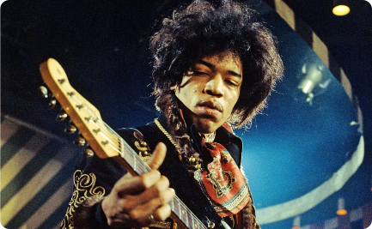
Continue statement
Example 1
Example 2
Example 3
Checking how many hours you have worked in a week, ignoring the breaks.
Checking which students have passed or failed in a class, skipping the absentees.
Determining which musical notes were hit correctly, ignoring any wrong notes.

Slide 9

Pass statement
1
Example 1
2
Example 2
3
Example 3
Creating an empty function and adding it later.
Setting up a framework for a class and adding the methods later.
Providing structures for future error handling codes.

